Slide 1
PyTorch Group Study
Week 8 Section 6.1~6.3
Inoue lab. M1 Koki Hibi

Slide 2
Today’s Outline
6.2 Basis of NLP
IMDb dataset
Preprocessing words
one-hot vector
padding
Word embedding
6.3 Improvement
Pack Padded Sequences
Use trained emvedded words
Bidirectional LSTM
Multilayer LSTM
Regularization

Slide 3
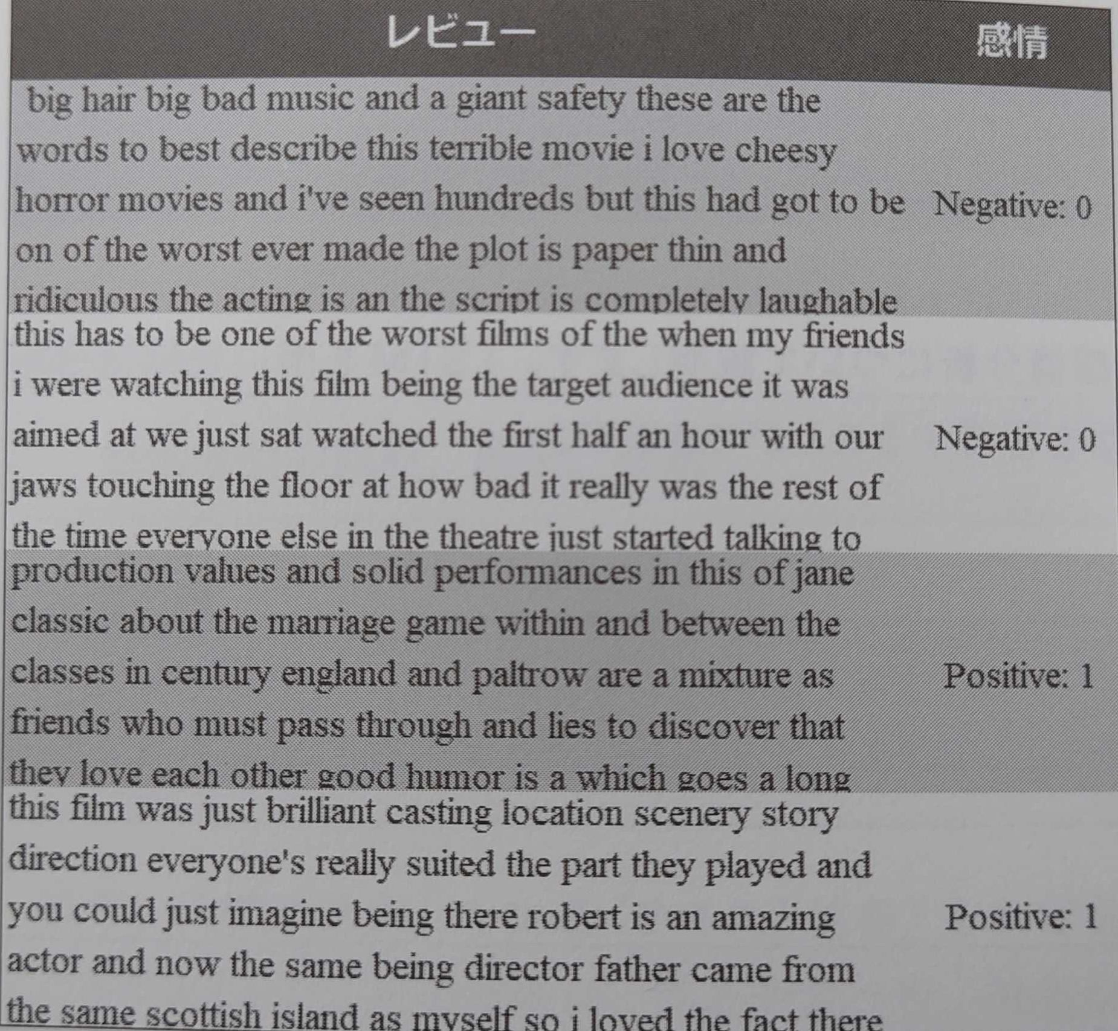
6.2 IMDb dataset
Movie review
25000 data each in Train / Test
Same proportion of “Pos” / “Neg” reviews in Train / Test
Only ”Pos” or ”Neg”

Slide 4
Work flow
Tokenize text, convert label to numerical value
Divide into train / test
Convert to one-hot vector, pick frequent words
embedding layer
LSTM

Slide 5
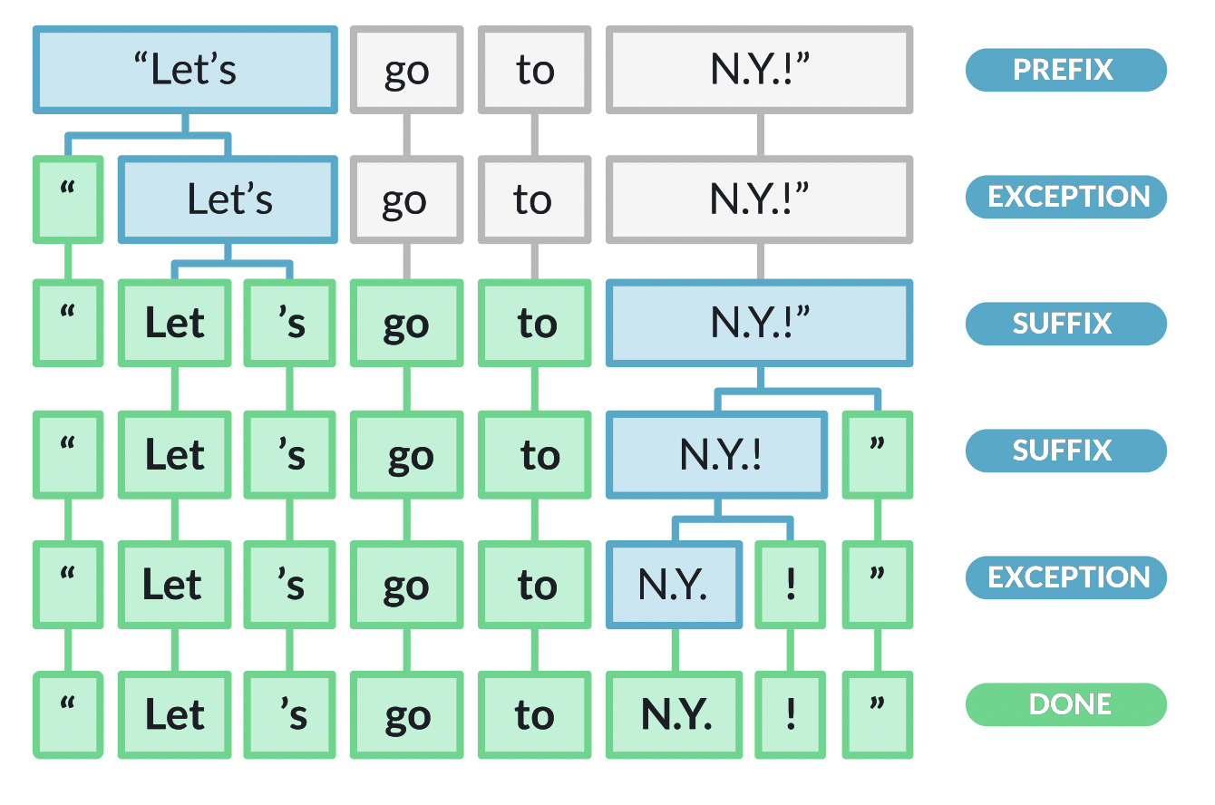
Tokenize text, convert label to numerical value
spaCy : Common Natural Language Processing library
Text label
“Let’s go to N.Y.!” pos
1
https://spacy.io/usage/linguistic-features#how-tokenizer-works

Slide 6
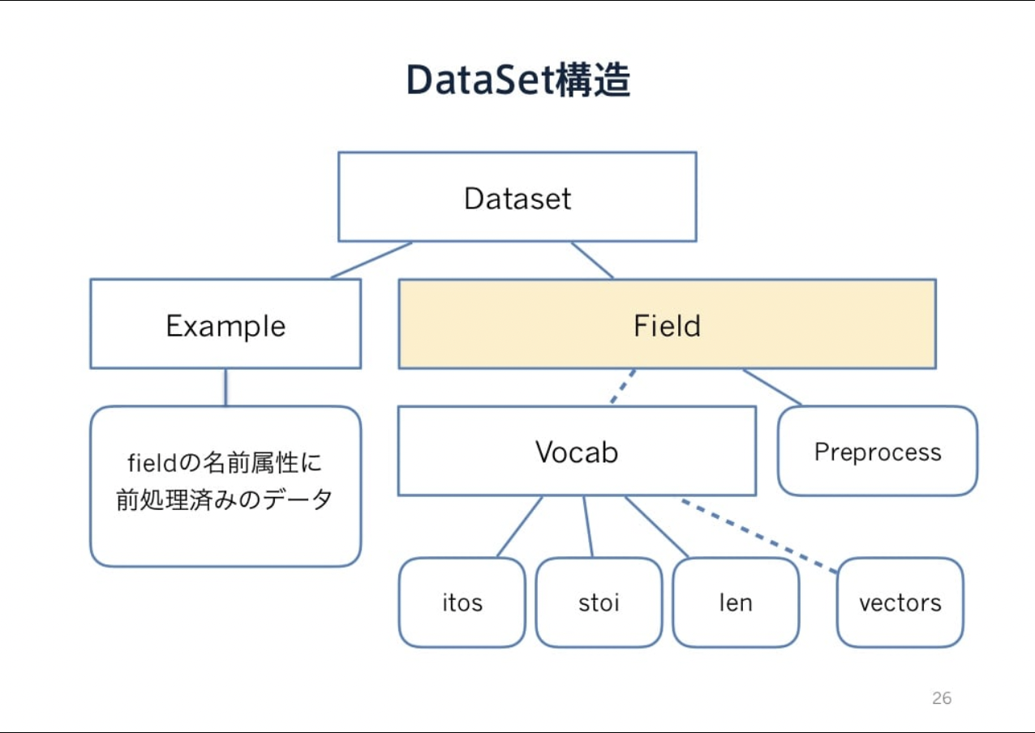
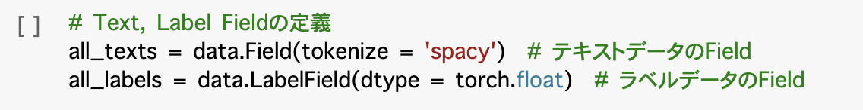
TorchText
Field : Class in TorchText
Defines a datatype
Instructions for converting to Tensor
Only tokenizing and converting label to float in “Section6-2.ipynb”
Vocab class is under Field class
https://www.slideshare.net/DeepLearningJP2016/dlhacks-lt-pytorchdataloader-torchtext

Slide 7
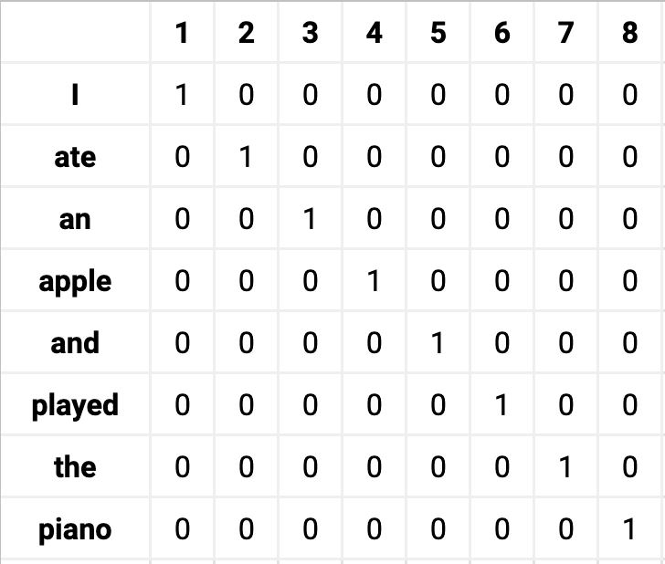
Preprocessing words
one-hot vector Too many dims ... Replace infrequent words to unknown : <unk>
To iterate, we need to match the length padding : <pad>
https://towardsdatascience.com/word-embedding-in-nlp-one-hot-encoding-and-skip-gram-neural-network-81b424da58f2
I | hate | this | film | .
This | film | sucks | . | <pad>

Slide 8
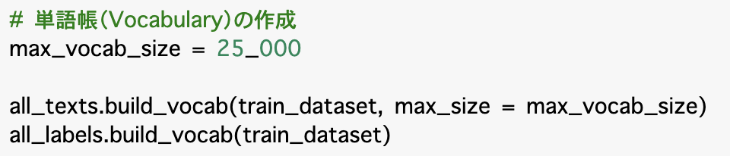
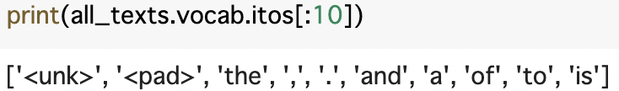
How to make reduced one-hot vector
Make word dictionary by “build_vocab” method
Index corresponds to word
Can be made in order of frequency
<unk>, <pad> also has corresponding index
Use Train data (because Test data should be unknown)
25002 dims in this case
Use “BucketIterator” Minimizes the # of <pad>
I | like | this | . | <pad> | <pad> | <pad> | <pad> | <pad> | <pad>
I | love | this | film | . | <pad> | <pad> | <pad> | <pad> | <pad>
This | film | is | the | best | one | in | my | life | !

Slide 9
How to make reduced one-hot vector
Make word dictionary by “build_vocab” method
Index corresponds to word
Can be made in order of frequency
<unk>, <pad> also has corresponding index
Use Train data (because Test data should be unknown)
25002 dims in this case
Use “BucketIterator” Minimizes the # of <pad>
I | like | this | . | <pad> | <pad> | <pad> | <pad> | <pad> | <pad>
I | love | this | film | . | <pad> | <pad> | <pad> | <pad> | <pad>
This | film | is | the | best | one | in | my | life | !

Slide 10
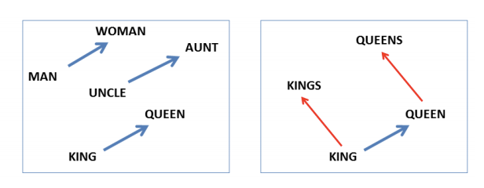
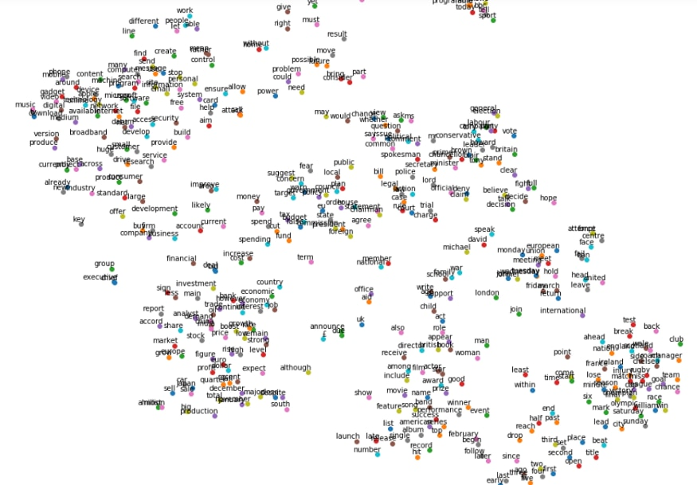
Word Embeddings (Vectors)
Distributed representation
Word2vec is popular Can guess the missing words in sentences.
https://dev.classmethod.jp/articles/mrmo-ml-20190920/
https://towardsdatascience.com/understanding-word2vec-embedding-in-practice-3e9b8985953

Slide 11
one-hot encoding
batch size
vocab dim (25002)
...
...
...
...
...
...
...
...
len

Slide 12
Embedding
batch size
vocab dim (25002)
embedding dim (100)
0.2 | 9.1 | ... | ... | 3.2
2.9 | ... | ... | ... | ...
5.5 | ... | ... | ... | ...
4.7 | ... | ... | ... | ...
... | ... | ... | ... | ...
... | ... | ... | ... | ...
... | ... | ... | ... | ...
1.7 | ... | ... | ... | 0.6
W
len

Slide 13
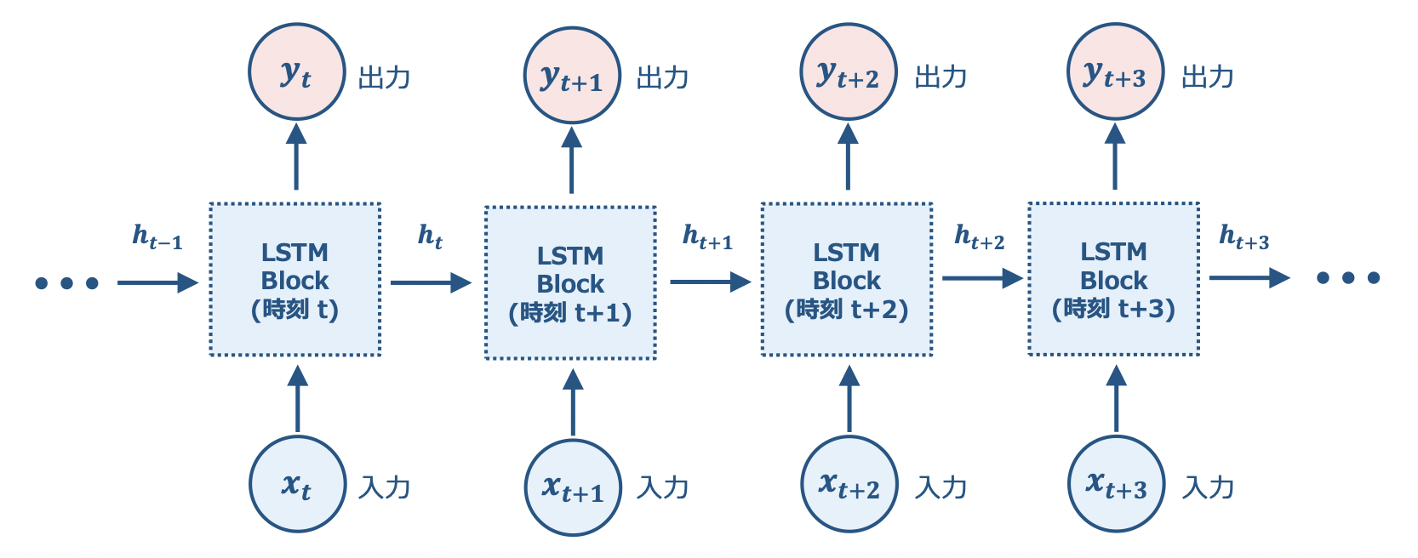
LSTM
0.2 | 9.1 | ... | ... | 3.2
2.9 | ... | ... | ... | ...
5.5 | ... | ... | ... | ...
https://jp.mathworks.com/content/dam/mathworks/mathworks-dot-com/company/events/webinar-cta/2514077_JP_2018-09-07_Deep_Learning_LSTM_1.pdf
4.7 | ... | ... | ... | ...

Slide 14
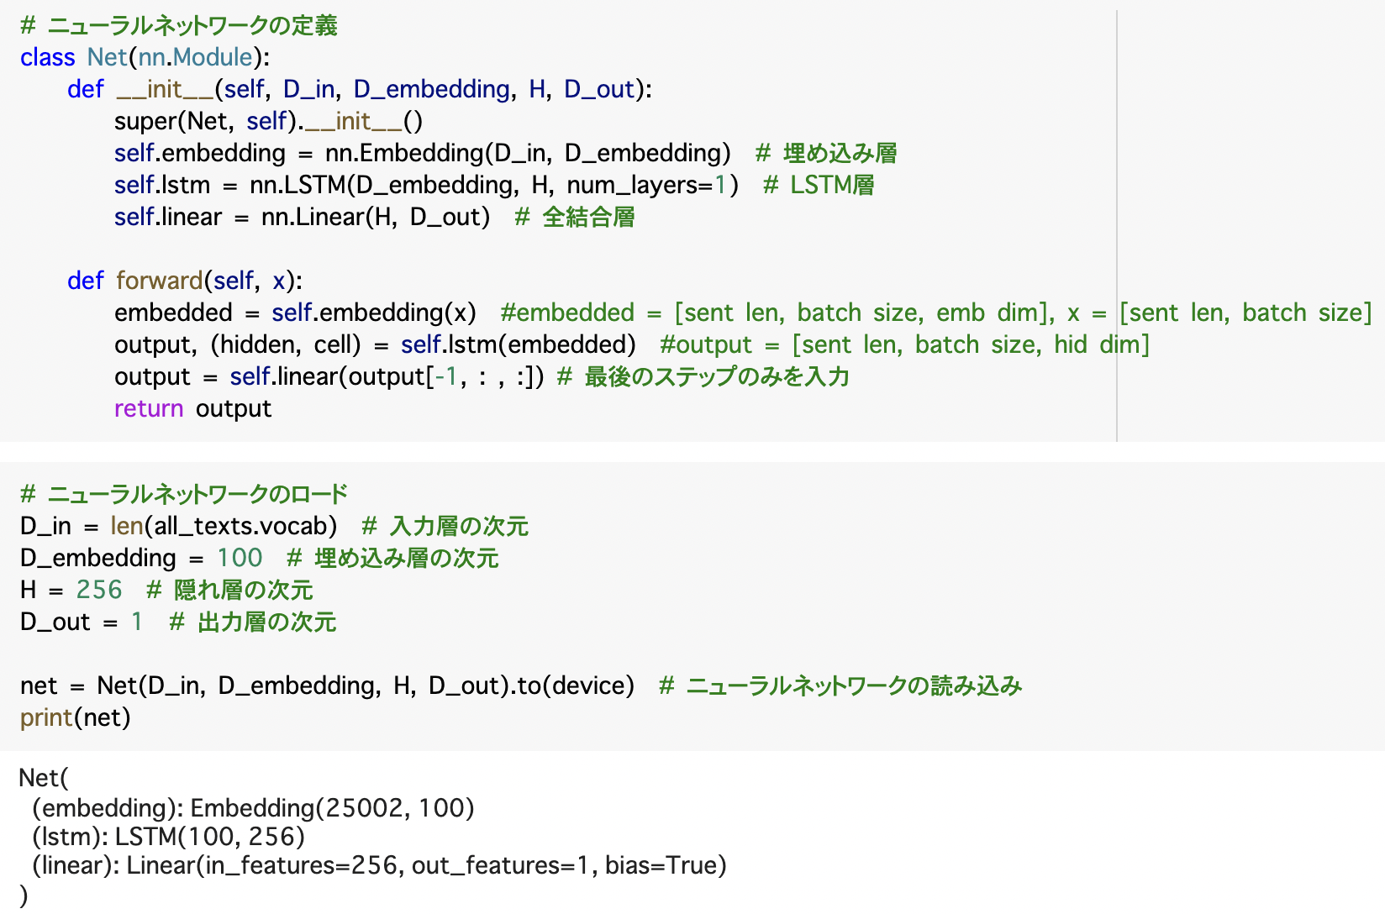
Neural Network coding

Slide 15
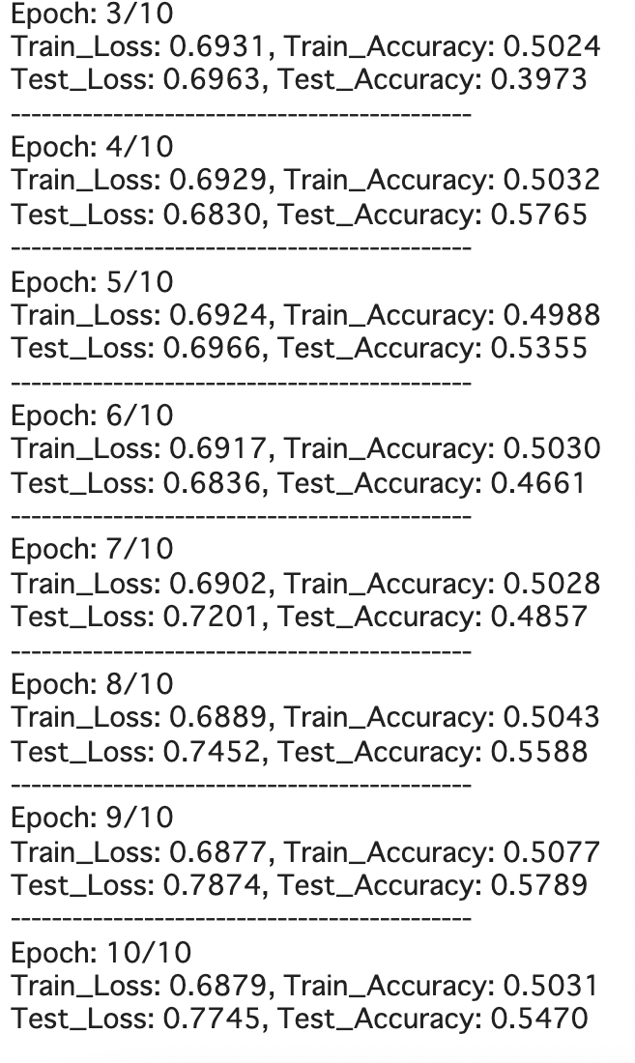
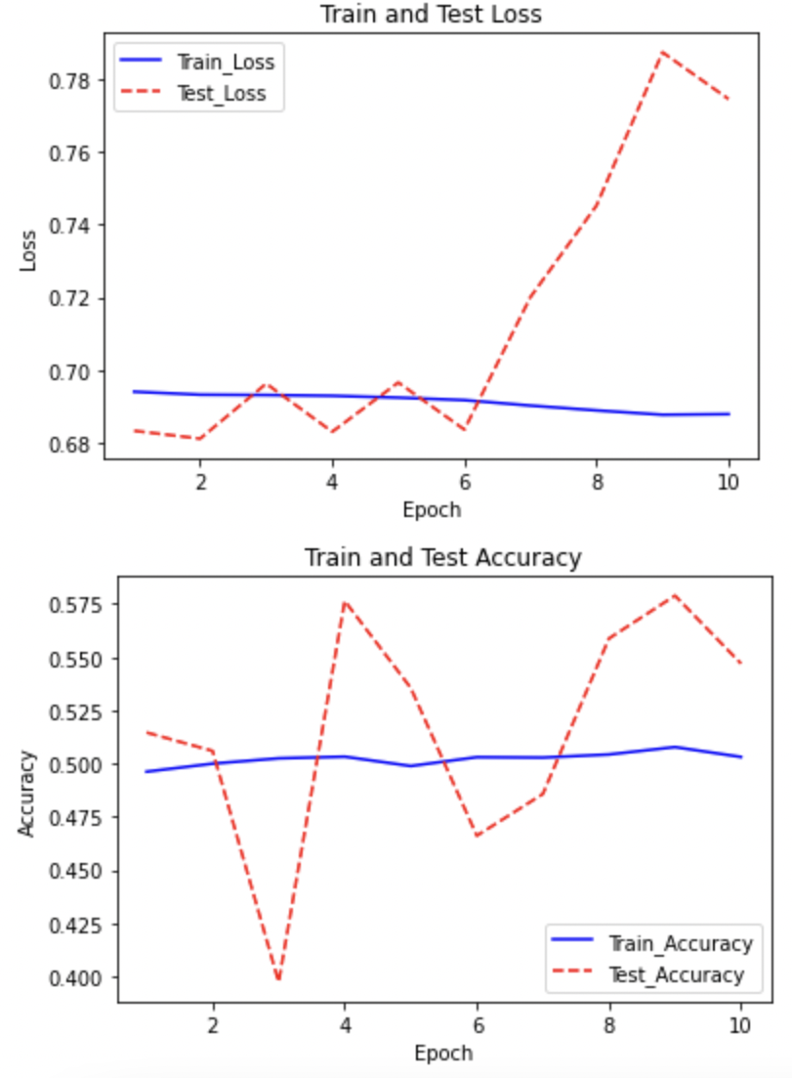
Learning results
Bad result...
Therefore, we will try to improve this in Sec. 6.3

Slide 16
Learning results
However, there was a critical mistake
Bad result...
Therefore, we will try to improve this in Sec. 6.3

Slide 17
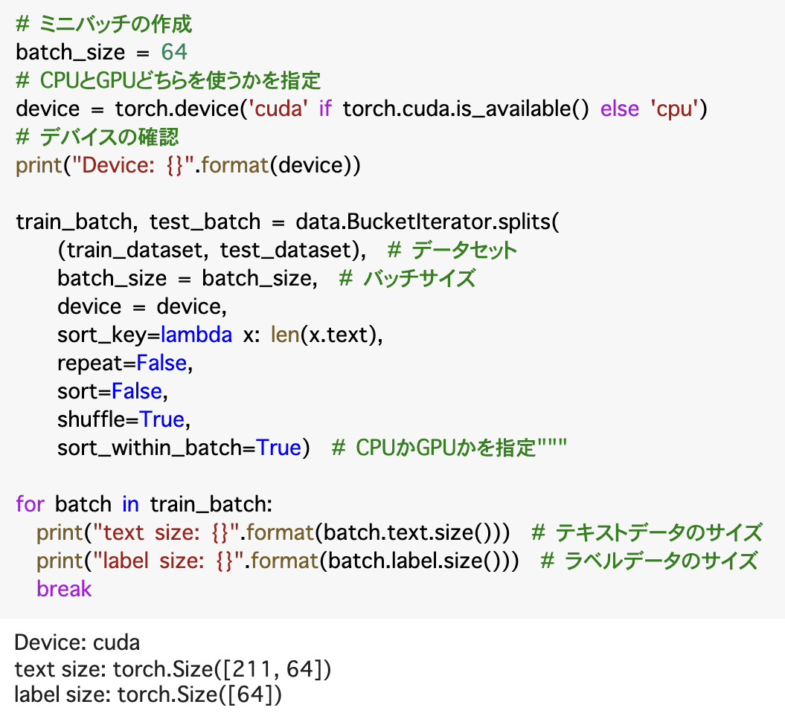
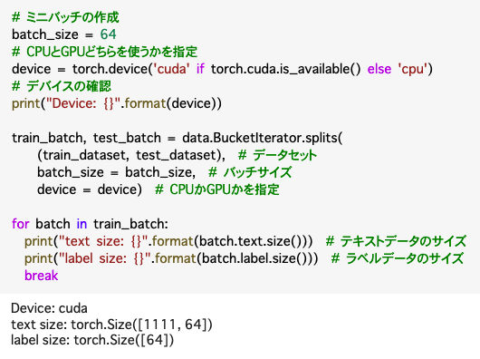
BucketIterator
Minimizes the # of <pad> if the “sort_key” variable is given.

Slide 18
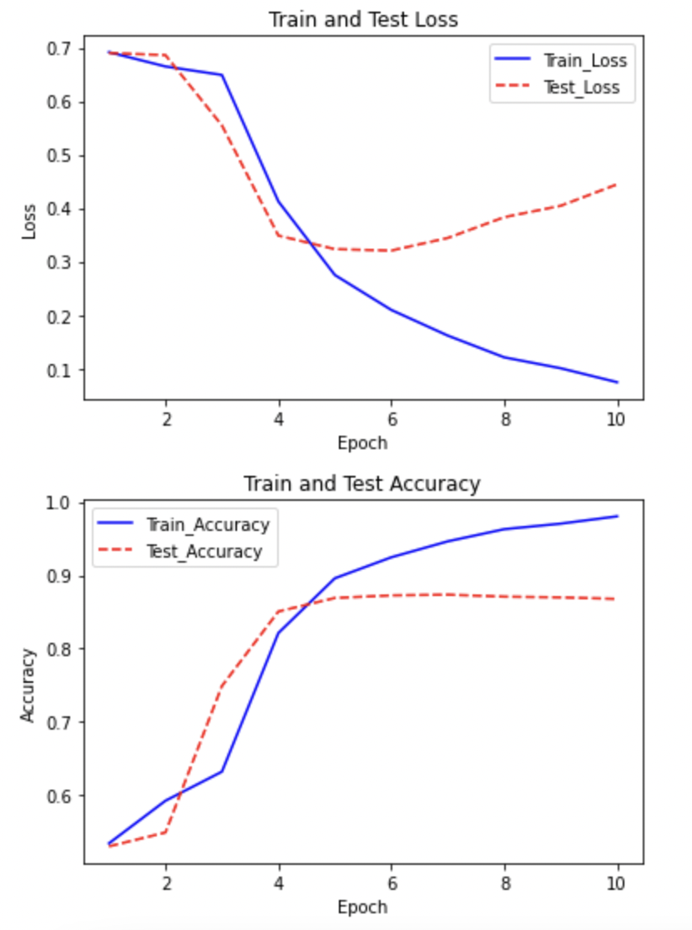
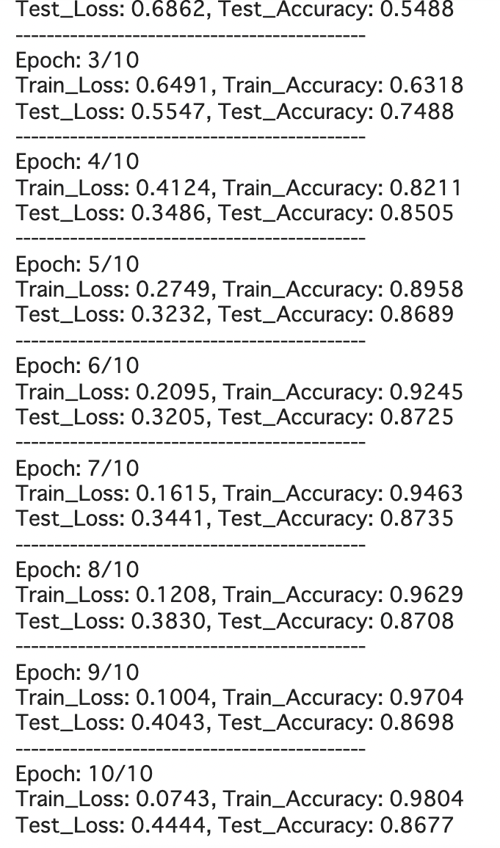
Actual learning results
Fantastic result! Overlearning begun already.
Q. Too many <pad> affects the accuracy?

Slide 19
6.3 Outline
Pack Padded Sequences
Use trained embedded words
Bidirectional LSTM
Multilayer LSTM
Regularization

Slide 20
Pack Padded Sequences
×: packed ○: pack
Sequence: Data (Tensor)
pad_sequences: 0 padding
pack_padded_sequences: Exclude pad while learning
In the textbook, pad is already done in “build_vocab” method

Slide 21
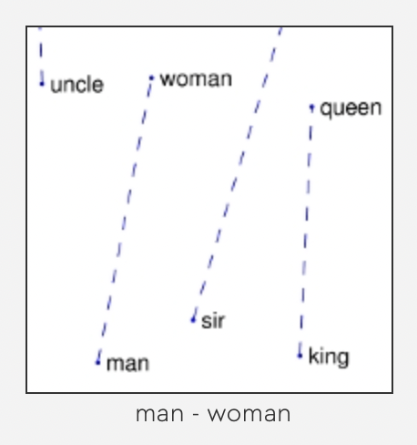
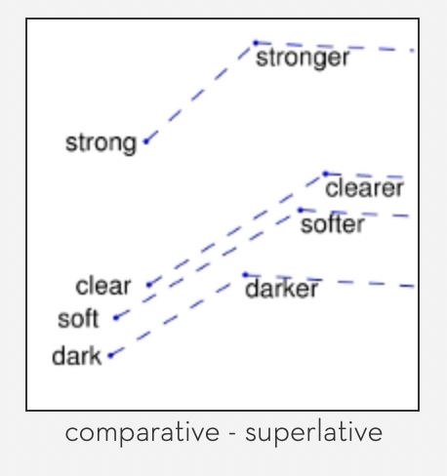
Use trained embedded words
In 6.2, we made it from one-hot vector. Now we use pretrained famous one.
GloVe
Stanford University
They say it is grater than Word2vec
http://nlp.stanford.edu/projects/glove/

Slide 22
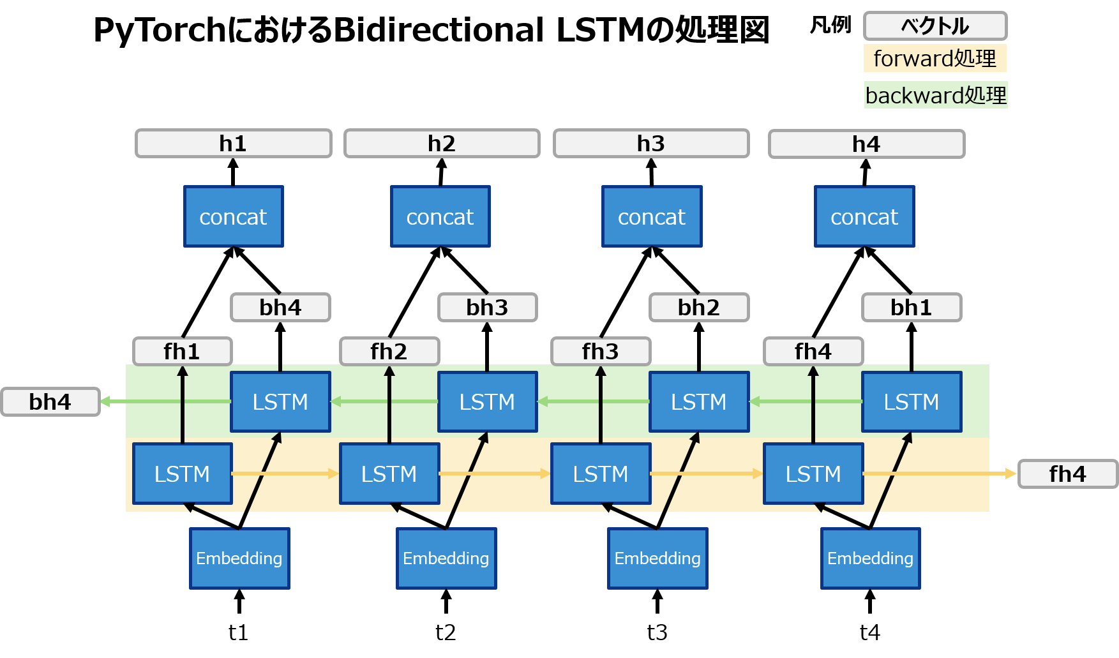
Bidirectional LSTM
https://qiita.com/m__k/items/78a5125d719951ca98d3

Slide 23
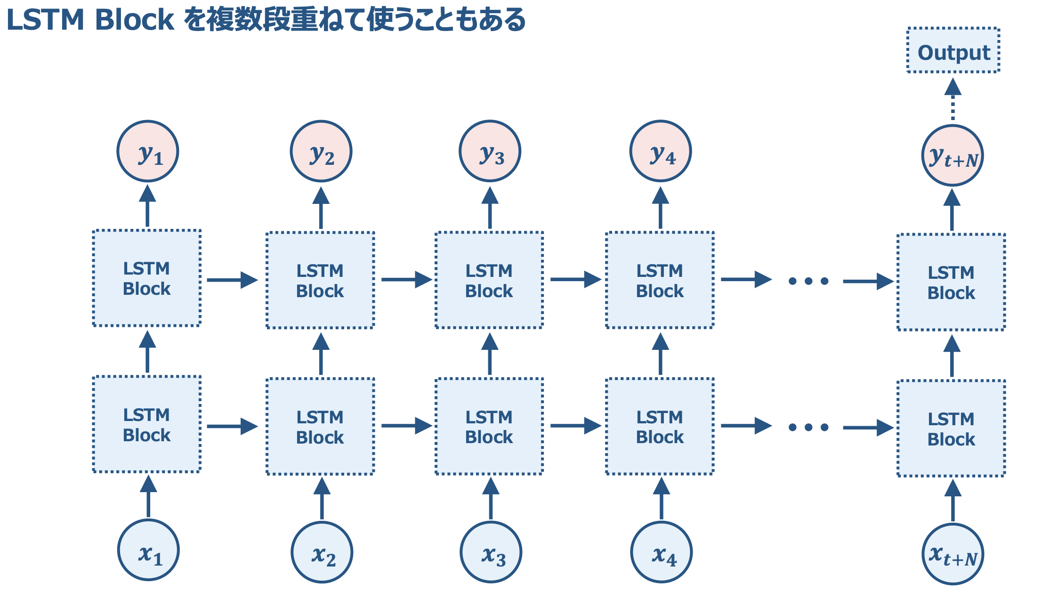
Multilayer LSTM
a
https://jp.mathworks.com/content/dam/mathworks/mathworks-dot-com/company/events/webinar-cta/2514077_JP_2018-09-07_Deep_Learning_LSTM_1.pdf

Slide 24
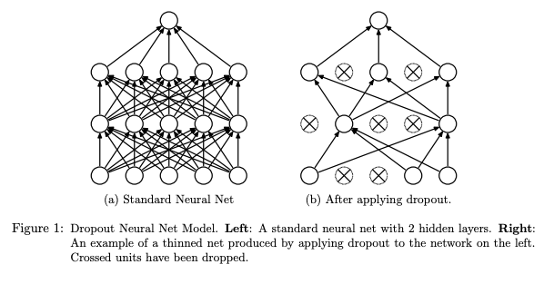
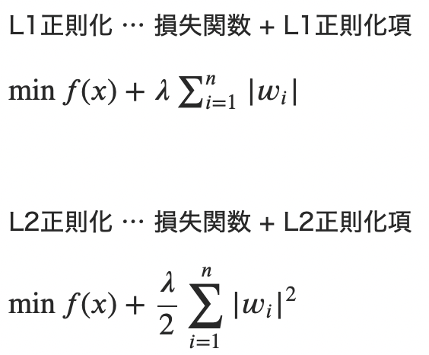
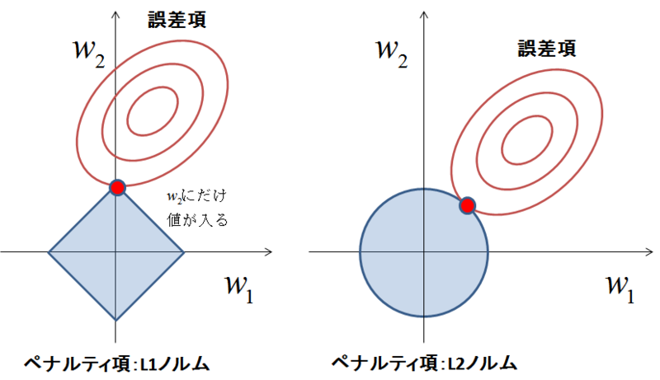
Regularization
To prevent overfitting, use regularization.
Dropout randomly zeroes some of the elements
Others
L1 regularization
L2 regularization
http://jmlr.org/papers/v15/srivastava14a.html
https://tjo.hatenablog.com/entry/2015/03/03/190000

Slide 25
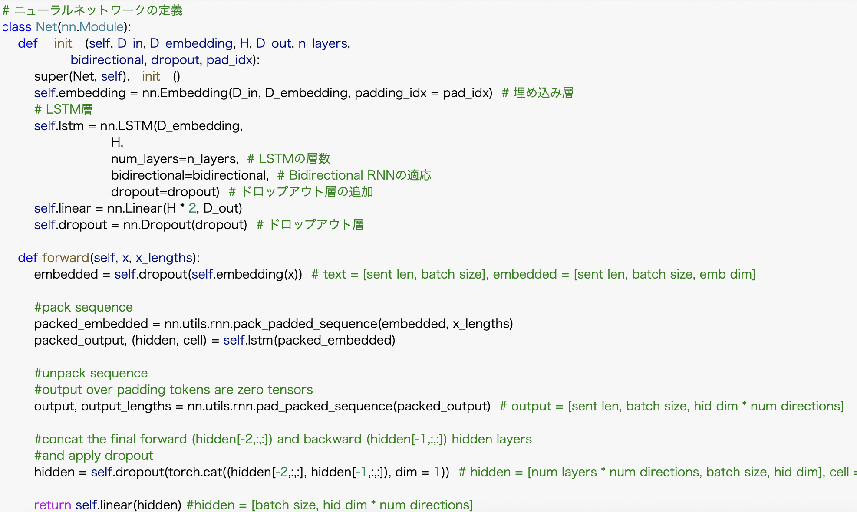
Neural Network coding

Slide 26
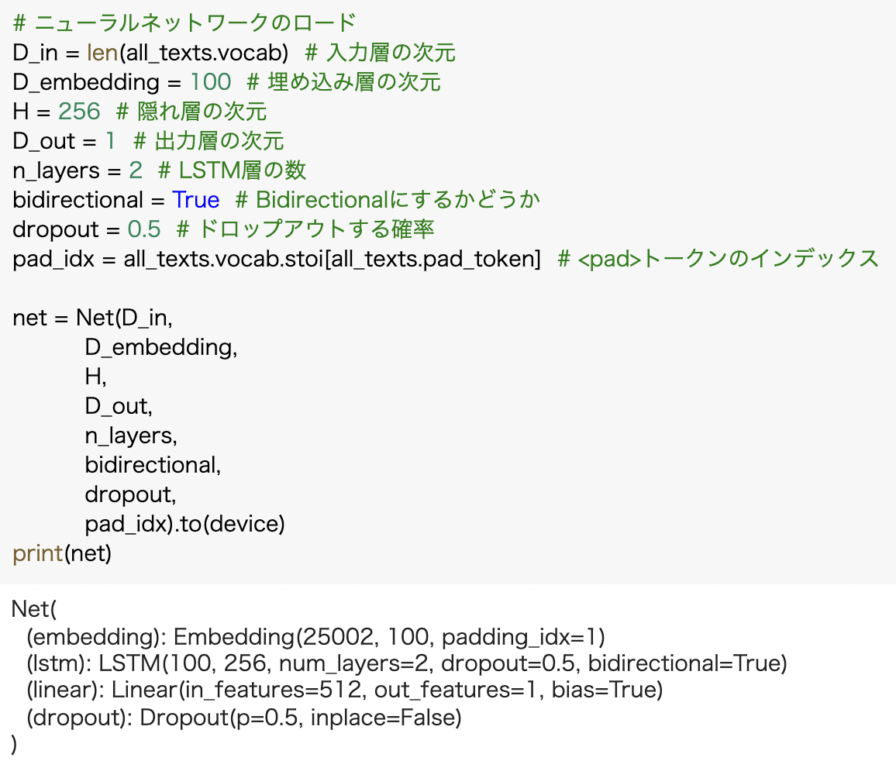
Neural Network coding

Slide 27
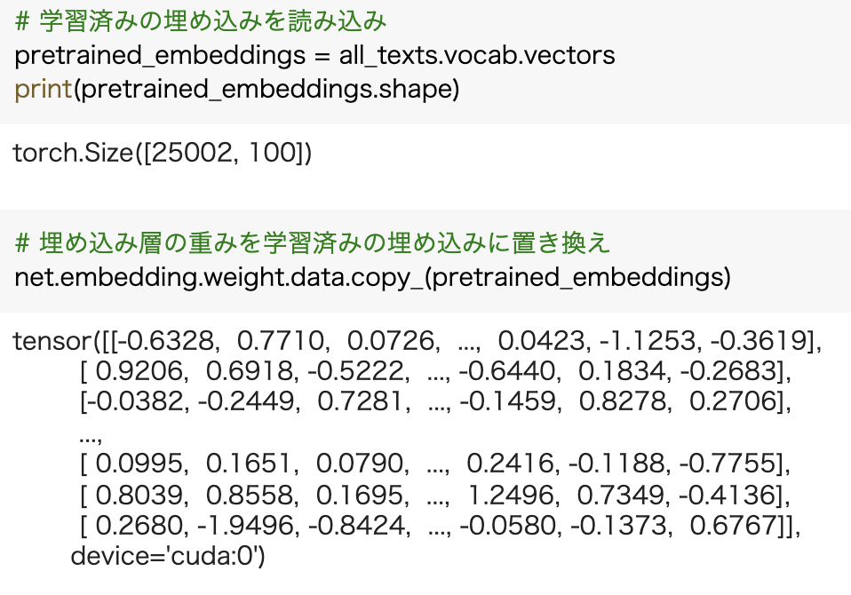
Neural Network coding

Slide 28
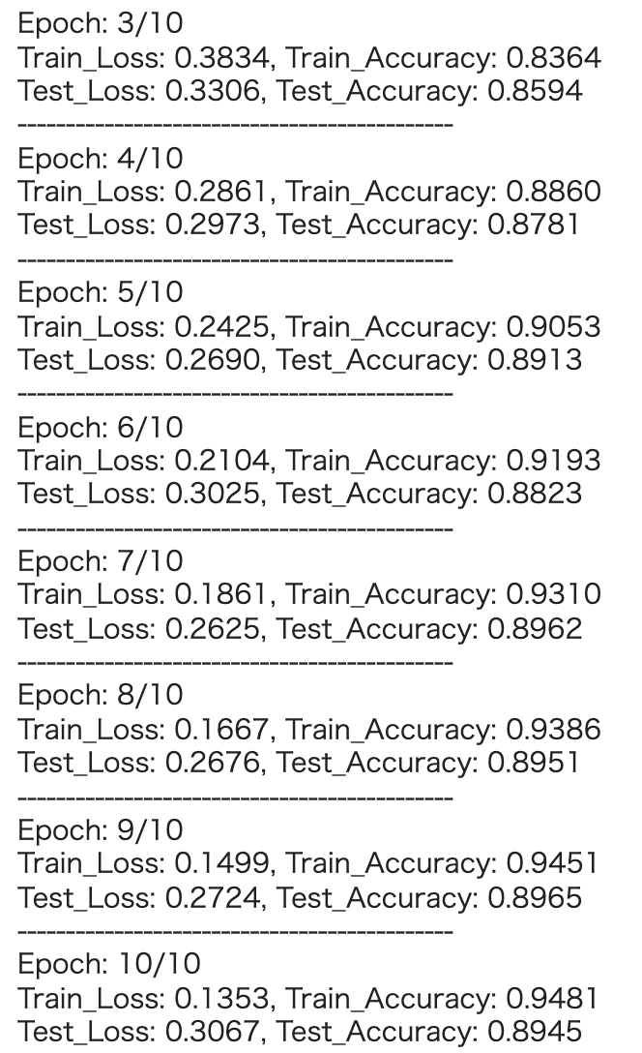
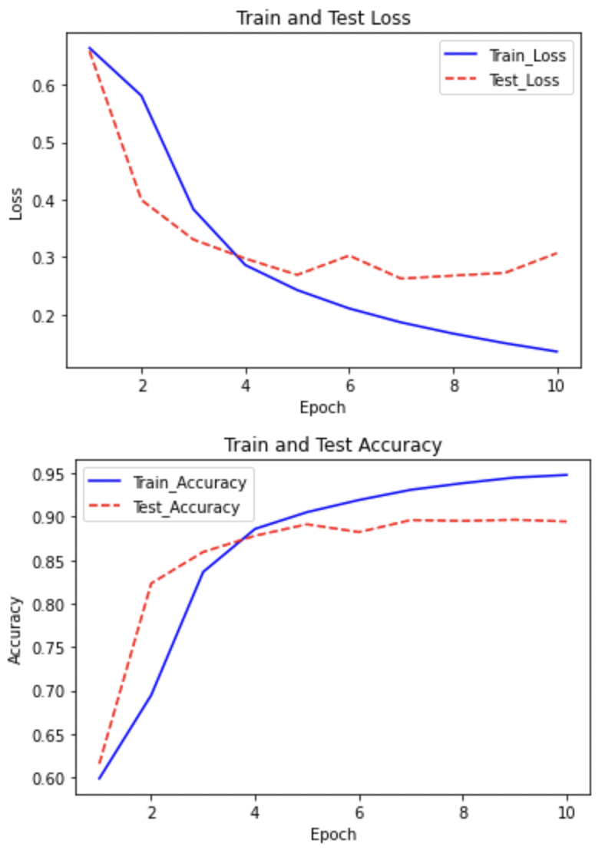
Learning results

Slide 29
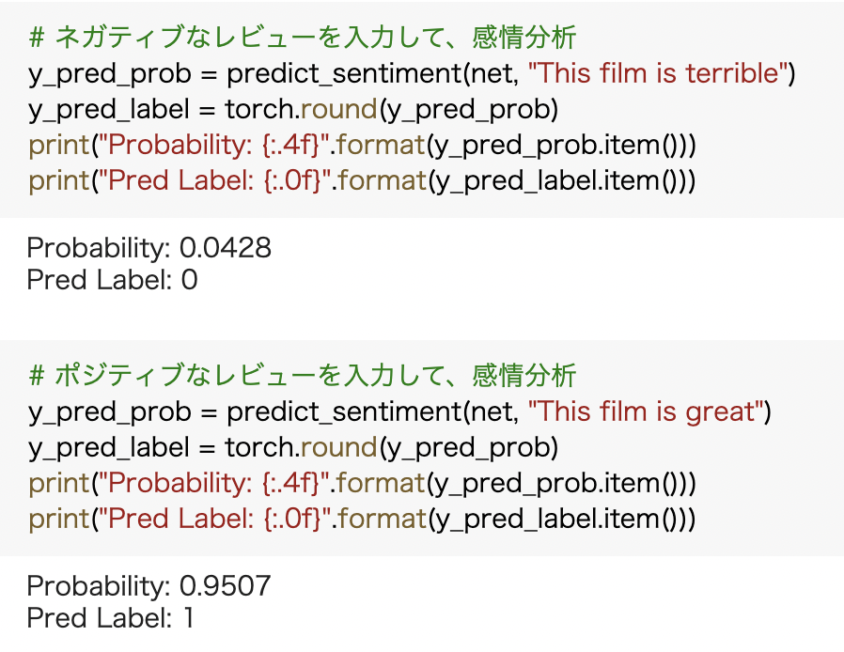
Results for new data

